Slide 1
“International travel helped open my eyes and become more in tune with the world around me.”
-Student Traveler

Slide 2
“I was able to explore new horizons and see the world from a different perspective. This adventure was one of the best I have experienced.”
-Student Traveler

Slide 3
“I will never forget how wonderful I felt when our plane landed. I learned so much about myself and for that I am grateful.”
-Student Traveler

Slide 4
“Students stepped out of their comfort zones. Friendships were strengthened as they experienced this event together.”
-Teacher

Slide 5
“Coming home, I feel more confident in my independence. I feel cultured and ultimately, I feel thankful for the friendships that I made on tour.”
-Student Traveler

Slide 6
“There aren’t enough adjective to describe this experience! It was utterly amazing. Incredible food, sites & experiences. Everyone must go!
-Teacher

Slide 7
“This tour helped my students immensely. Coming from a small, rural town, everything from the daily routines to the general atmosphere was mind-opening for the kids.”
-Teacher

Slide 8
“Introverts blossomed. Extroverts led and made sure everyone was included in the fun.”
-Teacher

Slide 9
Our Agenda
So what are we going to cover?
My travel story
Where and when
Our partnership with EF
Tour itinerary
What’s included (and what’s not)
Price and how to enroll

Slide 10
My name is
Ms. Freeman
11th year teaching/ 5th year at FHSA
7th Grade Mathematics
South Korea
Paris Nov 2018/ Italy March 2019

Slide 11
Additional
chaperone
Tranice Johnson – 6th Grade Science

Slide 12
Let’s
Watch!
Notes:
If video gives you issues in browser: copy & paste the following into the browser
https://www.youtube.com/watch?v=fZXEcRLHO7U

Slide 13
Let’s go to…
EUROPE
✈
An 8-day tour | From London to Paris | March, 2020
Notes:
England – London

Slide 14
Mark your calendars
We’ll be traveling sometime between…
Earliest
departure
Latest
return
8 DAY TOUR
Wednesday,
March 11th, 2020
Sunday,
March 22nd, 2020
*We’ll confirm exact departure and return dates closer to tour.

Slide 15
Group Travel
Meet students from around the country
Keeps our tour affordable
Allows more students to see the world
Make lasting friendships
Tour and departure flexibility match us with other groups

Slide 16
EF Educational Tours
Our travel partner
World leader in international education
50+ years of experience
500 schools & offices in 53 countries
Guaranteed lowest price

Slide 17
Let’s talk safety
We’ve got you covered!
EF provides our group with
24/7 Tour Director
Local presence
24-hour emergency line
Peace of Mind Policy
Support for my safety policies
Notes:
EF Safety
Local and global presence
Chaperone to Student Ratio, every six students we will have chaperone from our school
Peace of Mind-EF will never send the group to a location they do not feel safe traveling so we have options to fall back on, if needed.
My Safety Policy/ My expectations
This is an extension of the classroom. We are here to learn but we will have a blast while doing it.
Keep in mind-You are representing your school, state and country

Slide 18
Who else is traveling with EF?
Dunbar Middle School
Maumelle Middle School
Pulaski Heights Middle School
E-STEM Junior High School
Central High School
Mt. Saint Mary’s

Slide 19
Educational Resources
Preparing for life after high school
HIGH SCHOOL CREDIT
COLLEGE CREDIT
COLLEGE APPLICATIONS
Earn credit
with a personal
project
Do college-level work and earn 3 credits
Use your tour to inspire your personal essay
Notes:
Whether you are thinking about it now or not, this opportunity will be something that you will be able to use and reflect on for years to come.
The great news is that this experience will be extremely educational. Students will be able to do a project around their tour experience, and if they want to take it to the next level there are three ways they can do that:
Option of earning FREE high school credit: EF is accredited just like our school
Option of earning college credits (3 credit hours)
The Uncommon App is a tool to help our students structure their college personal essay question

Slide 20
Let’s
Watch!
Notes:
Direction: If you have troubles with the video, copy & paste the following:
https://www.youtube.com/watch?v=VSET0UiqAsY

Slide 21
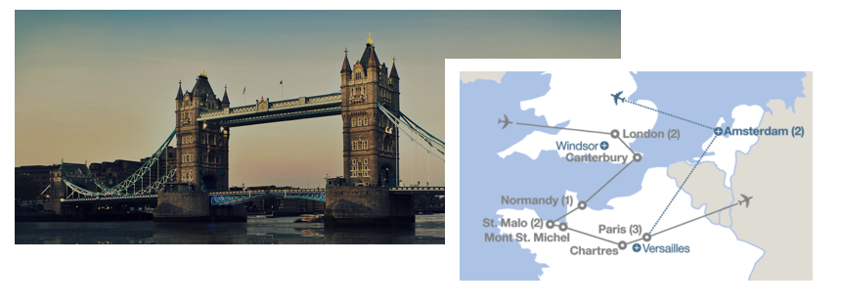
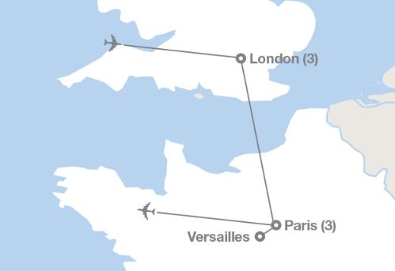
Our Itinerary
What we’ll see, do, eat, and experience
What are
you excited
about?

Slide 22
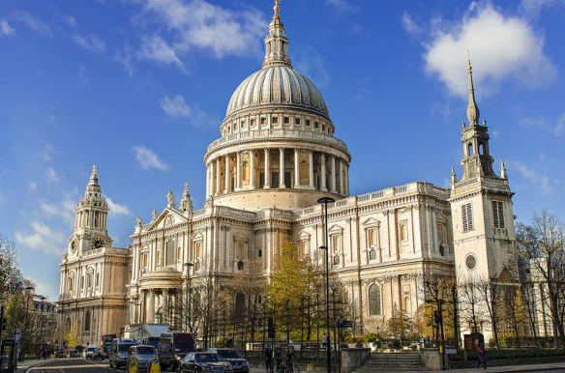
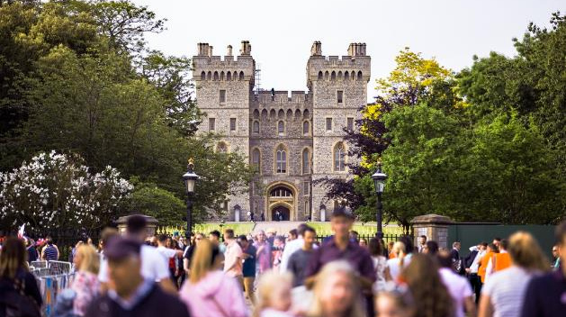
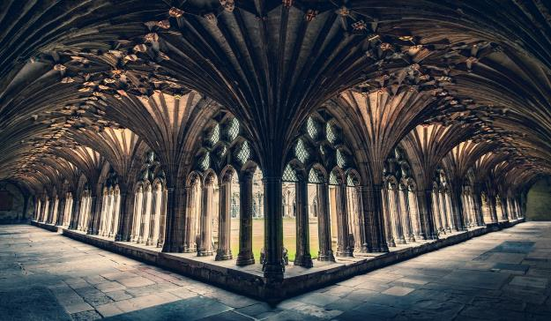
LONDON
PARIS
ST. PAUL’S
ARC DE TRIOMPHE

Slide 23
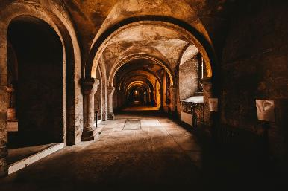
HIGHLIGHTS
Visit the Tower of London
See the Globe Theater
Visit the Natural History Museum
See Big Ben and Houses of Parliament
Prepare traditional French food during a cooking class
See the Eiffel Tower

Slide 24
What’s Included
Round-trip airfare
Safe, quality hotel rooms
24/7 bilingual Tour Director
On-tour transportation
Educational itinerary
Guided tours and activities
Breakfast and dinner daily
24/7 on-tour assistance
Traveler Support Team
Tour Donation Page
weShare online education platform
UnCommon App college essay toolkit
Travel backpack
Global Travel Protection Plan
(And a few things you'll need to cover)
Passport and visa fees
Airport baggage fees
Lunches and snacks
Spending money
Tips
Notes:
So, what’s included? Pretty much everything.
Not included: A few things. But no real surprises here. Once everyone is signed up I will hold a separate meeting for that student group to talk through all of these.

Slide 25
Making it happen
We’ve got options
$123
$245
$3,515
BI-WEEKLY
MONTHLY
IN FULL
DONATION PAGE
Notes:
So on to the next important topic. The price of the program.
You will see, we have lots of options and you can pick what works best for your family!
bi-weekly, monthly, or pay in full. If none of these work, give EF a call to talk about payment options.
You can also send out your tour donation page, so family and friends can donate towards your trip

Slide 26
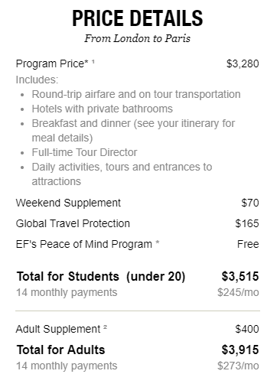
Making it happen
We’ve got options
$111
$221
$3,399
BI-WEEKLY
MONTHLY
IN FULL
DONATION PAGE
Notes:
So on to the next important topic. The price of the program.
You will see, we have lots of options and you can pick what works best for your family!
bi-weekly, monthly, or pay in full. If none of these work, give EF a call to talk about payment options.
You can also send out your tour donation page, so family and friends can donate towards your trip

Slide 27
Who’s in?
LIMITED SPOTS AVAILABLE
12
ENROLL AT
eftours.com/2209098YJ
ENROLLMENT ENDS
December 19th, 2018
Notes:
Note: 95 dollars down to enroll. Any questions can be directed to the enrollment booklet or 800-665-5364

